Slide 1

Cloud Audit Trail Trackers: Security and Compliance in the Cloud
Cloud Audit Trail Trackers are essential for ensuring security and compliance in cloud-based systems. They record and monitor user and system activities, providing a comprehensive view of events within your cloud environment. These trackers are vital for real-time monitoring, log collection and storage, analytics and reporting, integration with SIEM systems, compliance monitoring, data visualization, and ultimately, improved security and compliance in your cloud infrastructure. They can be customized to meet specific needs and help organizations maintain compliance with industry regulations.

Slide 2
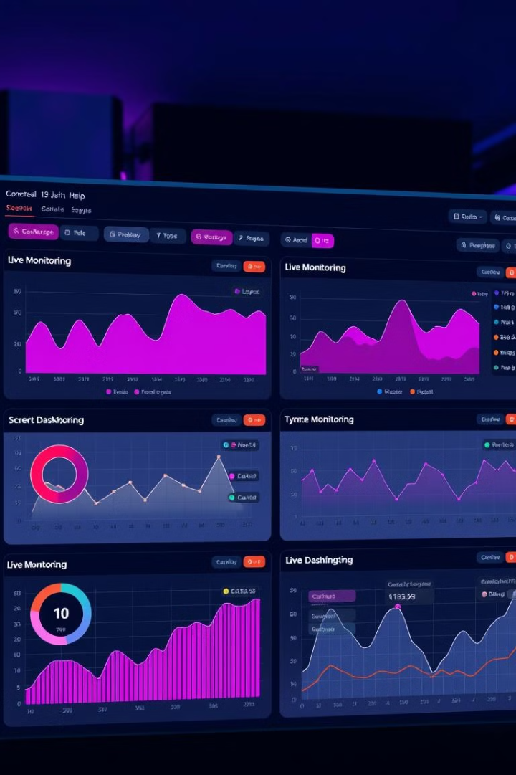
Real-time Monitoring
Real-time monitoring provides immediate visibility into user activity and system events. This enables proactive identification and response to potential threats or security breaches.
1
User Activity Tracking
Tracks user logins, file access, API calls, and other actions.
2
System Event Logging
Captures system events like resource creation, deletion, configuration changes, and error logs.
3
Alerts and Notifications
Generates alerts for suspicious activities, security events, and potential violations.

Slide 3
Log Collection and Storage
Cloud Audit Trail Trackers collect logs from various sources, including cloud services, network devices, and security tools. These logs are securely stored and indexed for analysis and retrieval.
Log Retention
Log Indexing
Log Encryption
Logs are stored for a specified duration, meeting regulatory compliance requirements.
Logs are indexed for quick and efficient search, enabling rapid analysis and incident response.
Logs are encrypted both at rest and in transit, ensuring data confidentiality and integrity.

Slide 4

Analytics and Reporting
Cloud Audit Trail Trackers provide comprehensive analytics and reporting capabilities, enabling organizations to gain insights from collected logs.
1
Trend Analysis
2
Security Incident Investigation
Identify patterns and anomalies in user activity and system behavior, enabling early detection of security threats.
Analyze logs to reconstruct events, pinpoint root causes, and determine the scope of security incidents.
3
Compliance Reporting
4
Performance Optimization
Generate reports for regulatory compliance audits, demonstrating adherence to security standards and policies.
Identify performance bottlenecks and areas for improvement based on system activity and resource usage.

Slide 5
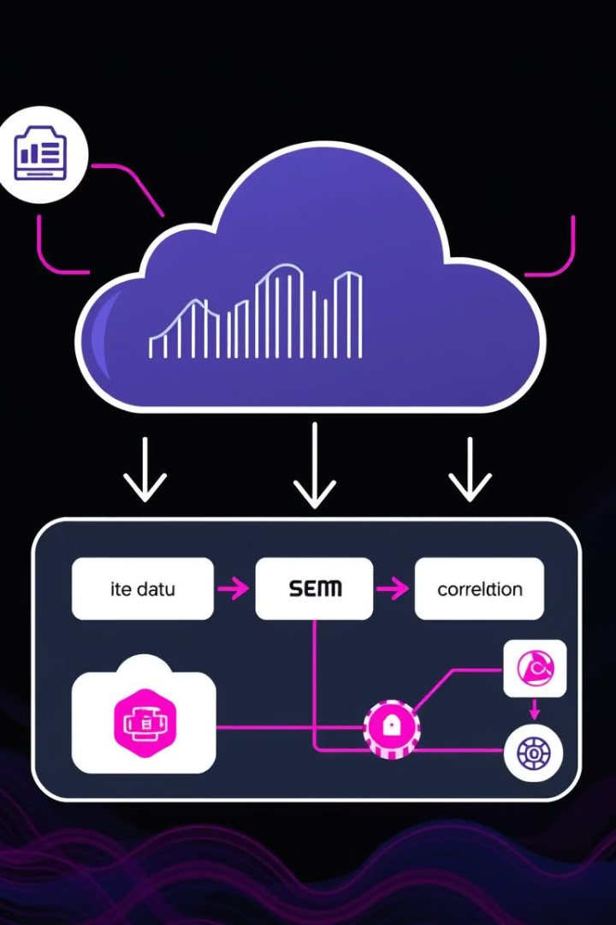



Integration with SIEM Systems
Cloud Audit Trail Trackers seamlessly integrate with Security Information and Event Management (SIEM) systems, providing a centralized view of security events across various systems.
Log Correlation
SIEM systems correlate logs from different sources, providing a comprehensive picture of security incidents.
Threat Intelligence
SIEM systems use threat intelligence to detect and prioritize potential threats, improving security posture.
Incident Response
SIEM systems automate incident response actions, such as blocking suspicious IP addresses or triggering alerts.

Slide 6

Compliance Monitoring
Cloud Audit Trail Trackers assist organizations in complying with industry regulations and security standards.
HIPAA
PCI DSS
Ensure compliance with the Health Insurance Portability and Accountability Act, protecting sensitive patient data.
Maintain compliance with the Payment Card Industry Data Security Standard, securing payment card data.
GDPR
SOC 2
Adhere to the General Data Protection Regulation, protecting the privacy of European Union citizens.
Demonstrate compliance with the Service Organization Control 2 standard, ensuring security and availability of cloud services.

Slide 7
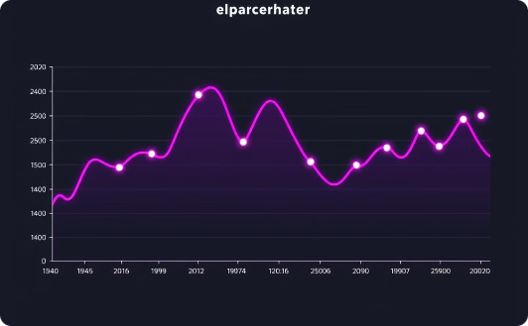
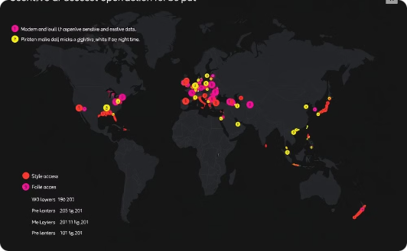
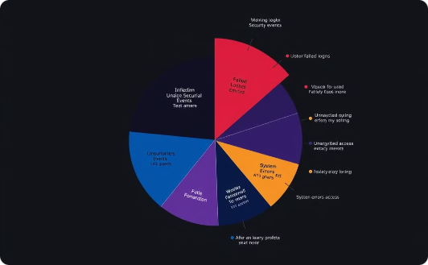
Data Visualization
Cloud Audit Trail Trackers offer data visualization tools, enabling organizations to gain insights from security data.
User Activity Trends
Geolocation Analysis
Security Event Categorization
Visualize user login patterns and identify potential unauthorized access attempts.
Analyze user activity based on geographic location, identifying suspicious access patterns.
Visualize security events by type, providing insights into common threats and security vulnerabilities.

Slide 8





Improved Security and Compliance
Cloud Audit Trail Trackers contribute to a more secure and compliant cloud environment, reducing risk and enhancing trust.
Data Protection
Security Posture Improvement
Regulatory Compliance
Auditing and Reporting
Protecting sensitive data from unauthorized access and breaches.
Ensuring adherence to industry regulations and standards.
Providing comprehensive audit trails and reports for regulatory compliance.
Strengthening security measures and proactively addressing vulnerabilities.

Slide 9
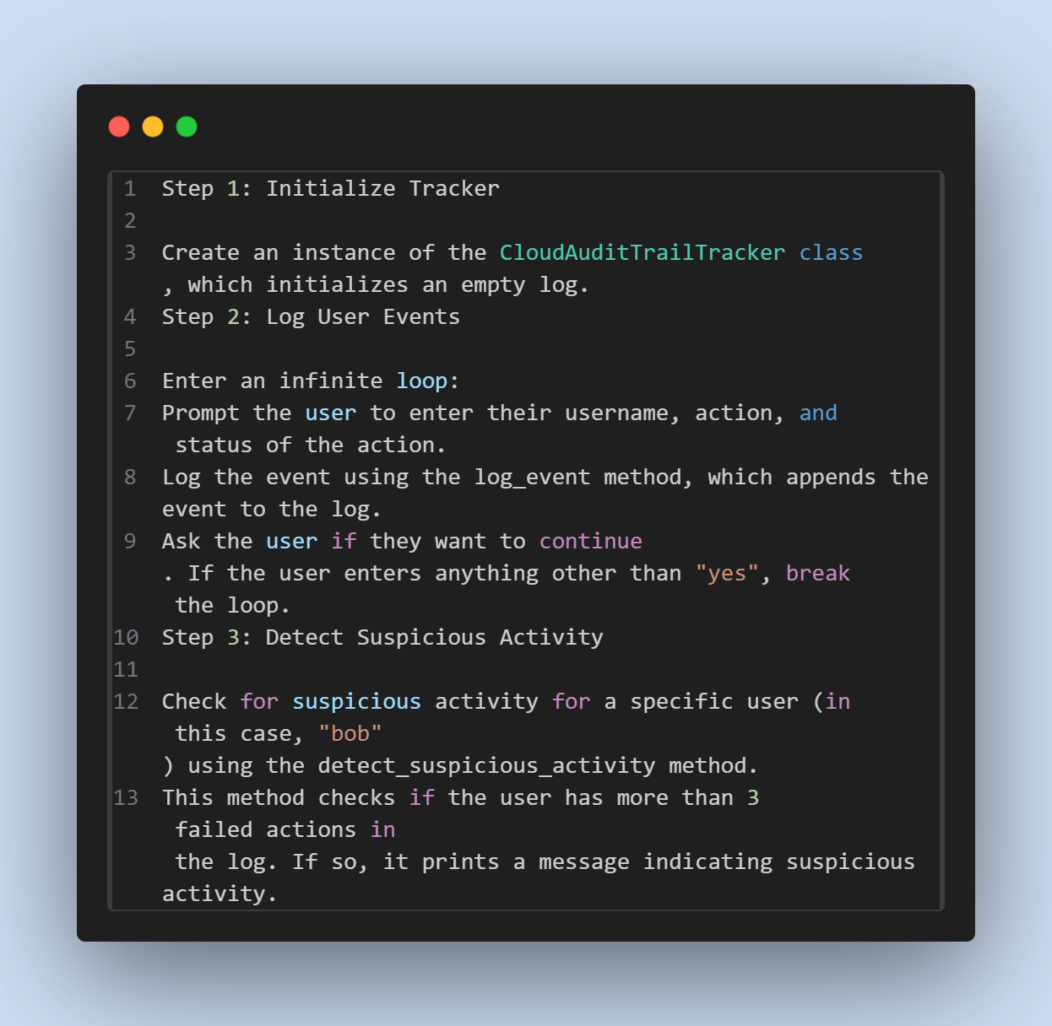

Slide 10
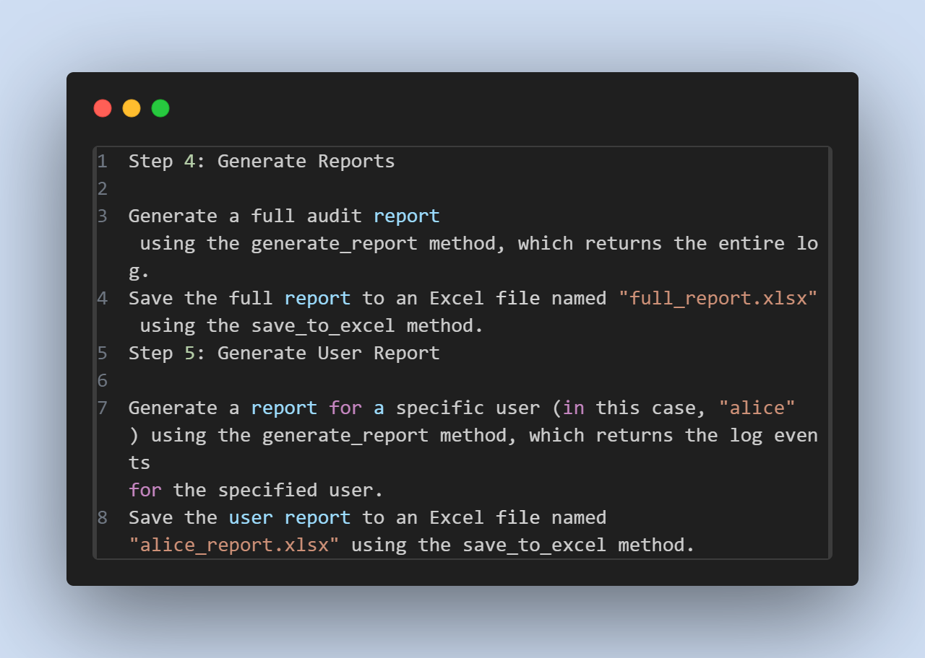

Slide 11
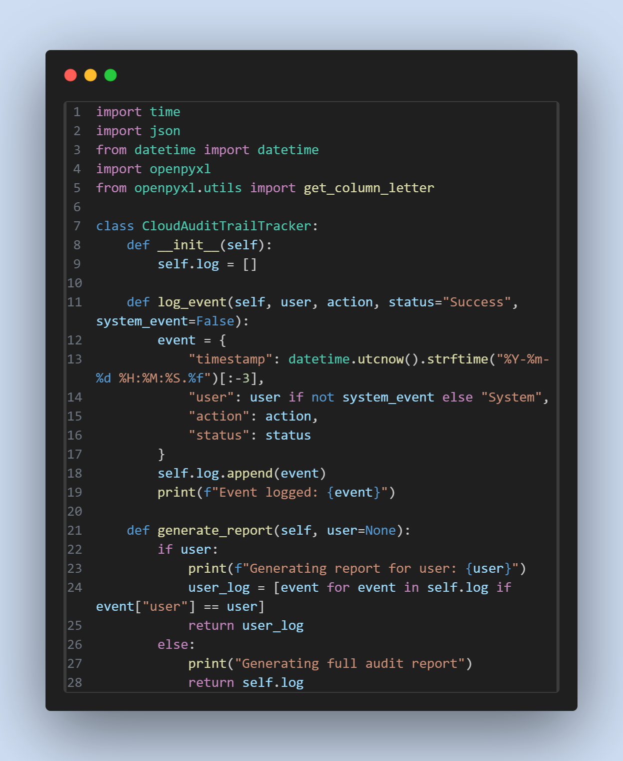
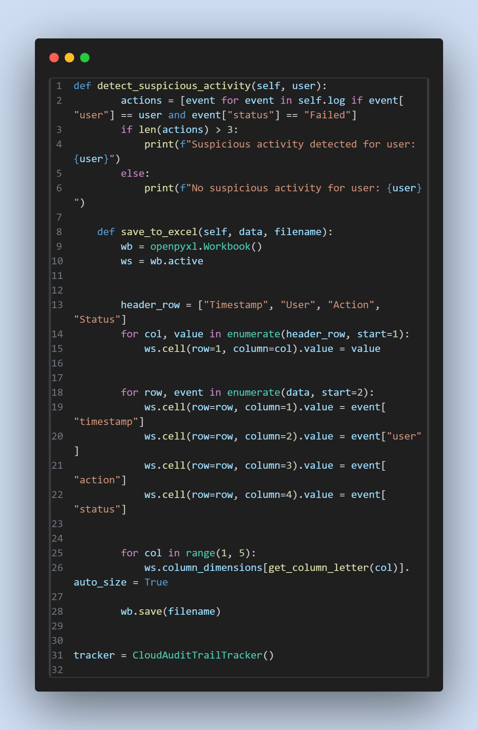

Slide 12
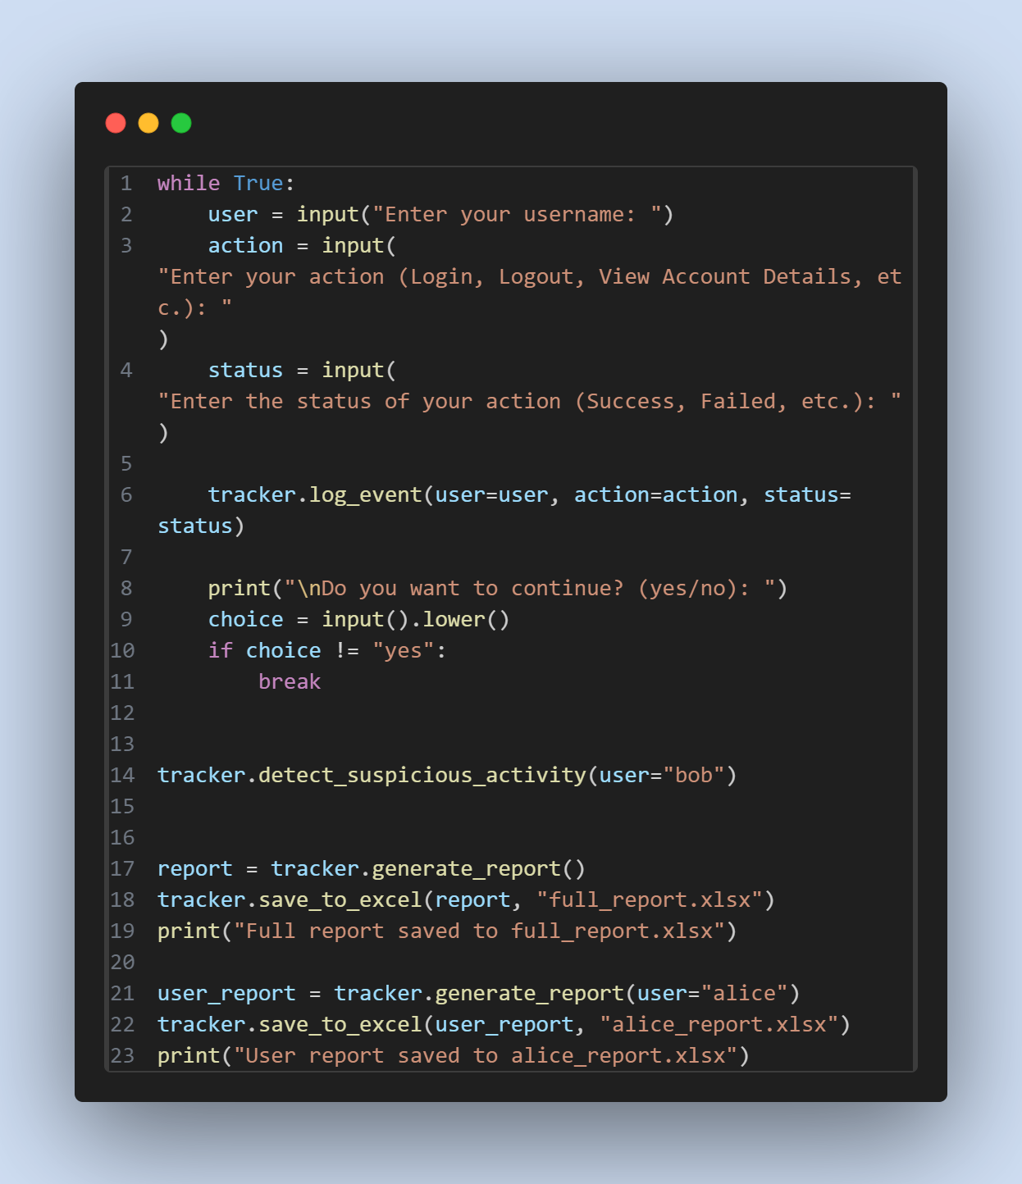

Slide 13


